Slide 1
Introduction to Database
Chapter Five Sales Order Problem

Slide 2
Content
A. Problem
B. Solution

Slide 3
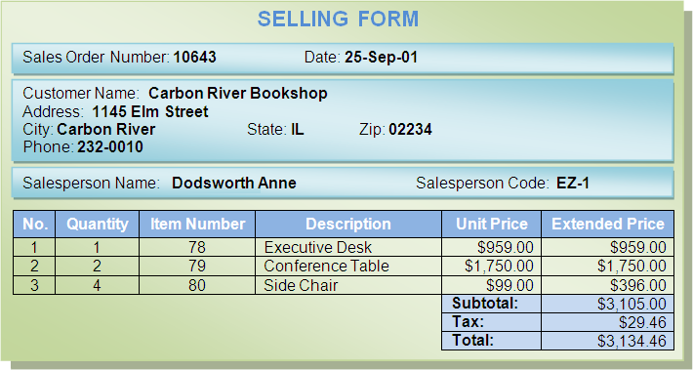
A. Problem
A company want to computerize all data. The followings are reports:

Slide 4
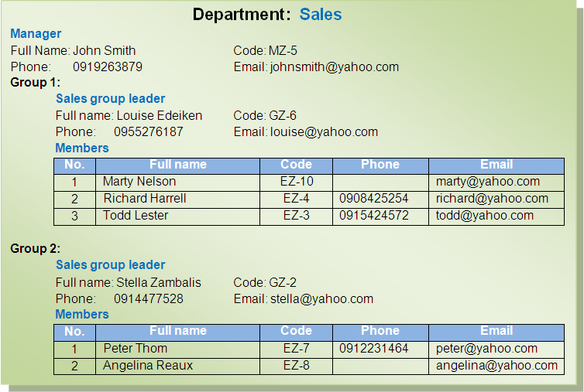
Let’s design DB diagram for above requirements

Slide 5
B. Solution
Logical Analysis
Physical Analysis

Slide 6
1. Logical Analysis
1.1. First solution
1.2. Second solution
1.3. Identify Recursive Relationship

Slide 7
1.1. First solution
1.1.1. Identify Entity
1.1.2. Identify Attribute
1.1.3. Identify Weak Entity
1.1.4. Identify Primary Identifier
1.1.5. Identify Alternative Identifier
1.1.6. Identify Mandatory Attribute
1.1.7. Identify Relationship

Slide 8
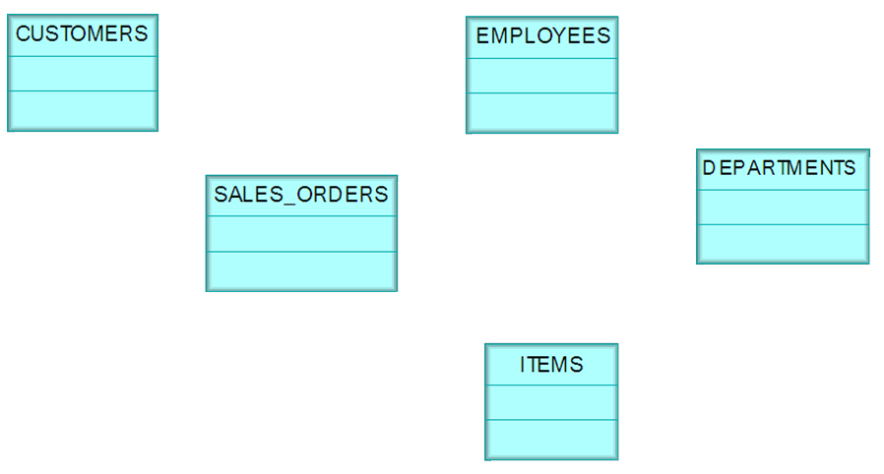
1.1.1. Identify Entity

Slide 9
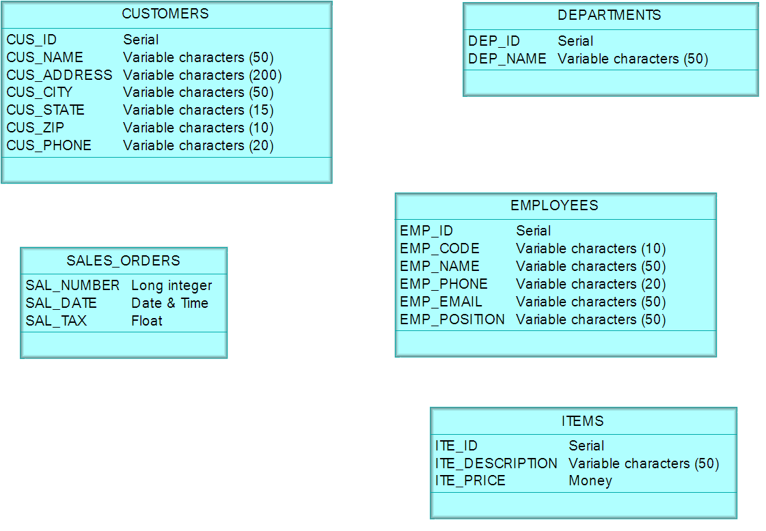
1.1.2. Identify Attribute

Slide 10
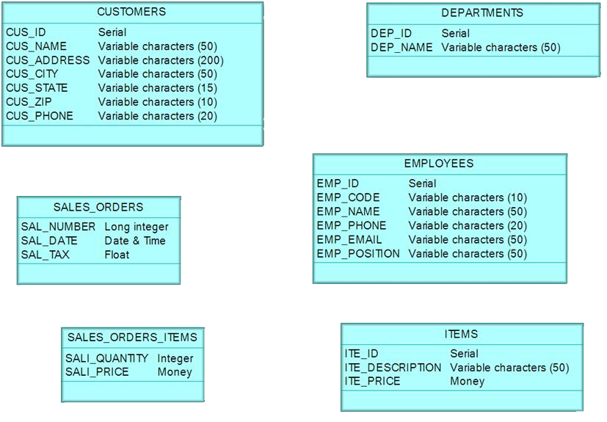
1.1.3. Identify Weak Entity

Slide 11
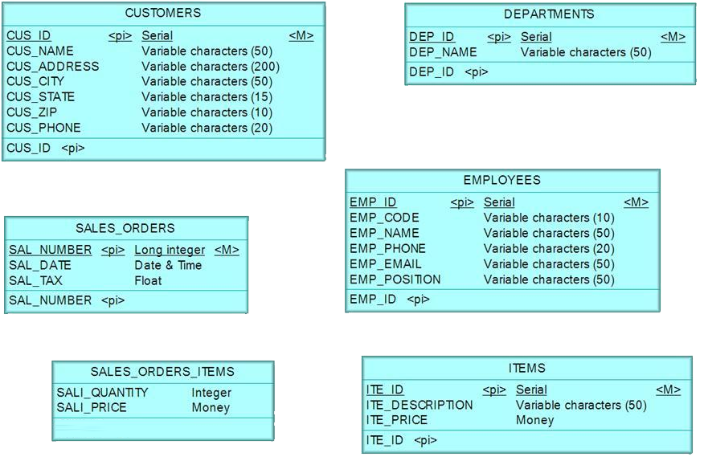
1.1.4. Identify Primary Identifier

Slide 12
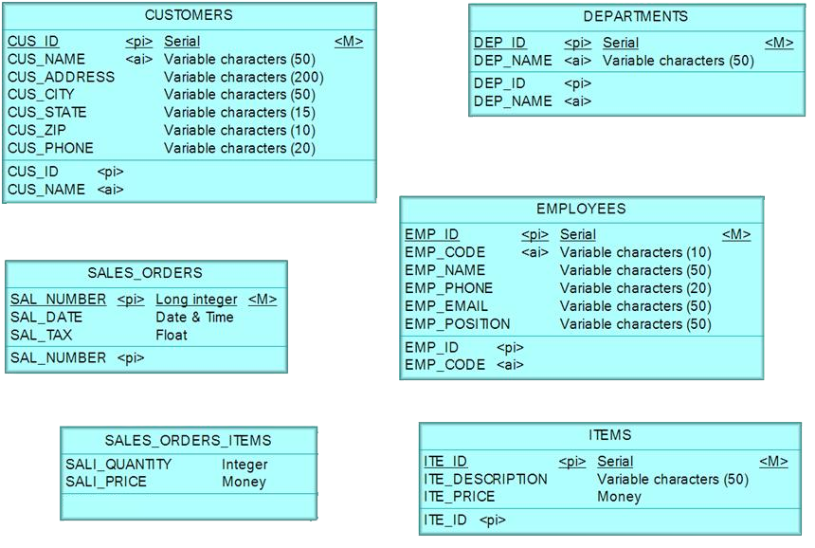
1.1.5. Identify Alternative Identifier

Slide 13
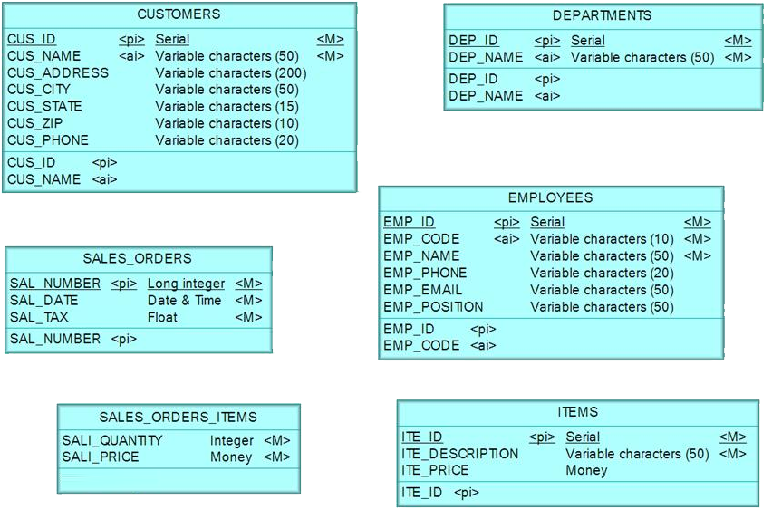
1.1.6. Identify Mandatory Attribute

Slide 14
1.1.7. Identify Relationship
1.1.7.1. Identify Maximum Cardinality
1.1.7.2. Identify Minimum Cardinality

Slide 15
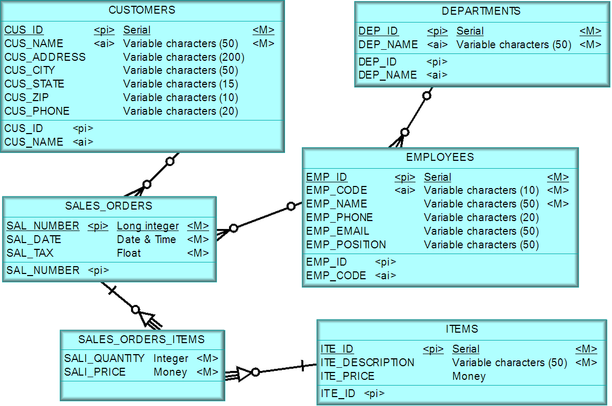
1.1.7.1. Identify Maximum Cardinality

Slide 16

1.1.7.2. Identify Minimum Cardinality

Slide 17
1.2. Second solution
1.2.1. Identify Entity
1.2.2. Identify Attribute
1.2.3. Identify Primary Identifier
1.2.4. Identify Alternative Identifier
1.2.5. Identify Mandatory Attribute
1.2.6. Identify Relationship

Slide 18
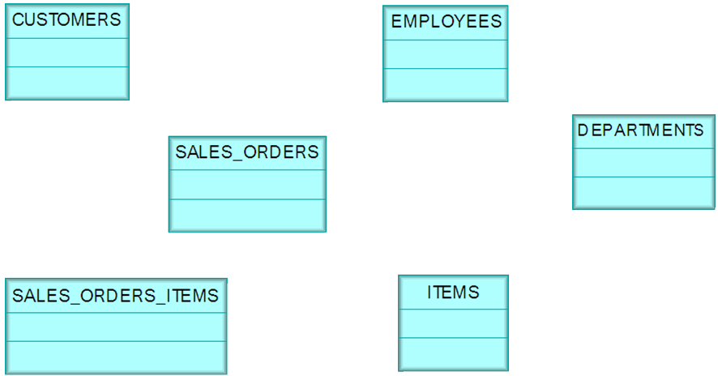
1.2.1. Identify Entity

Slide 19
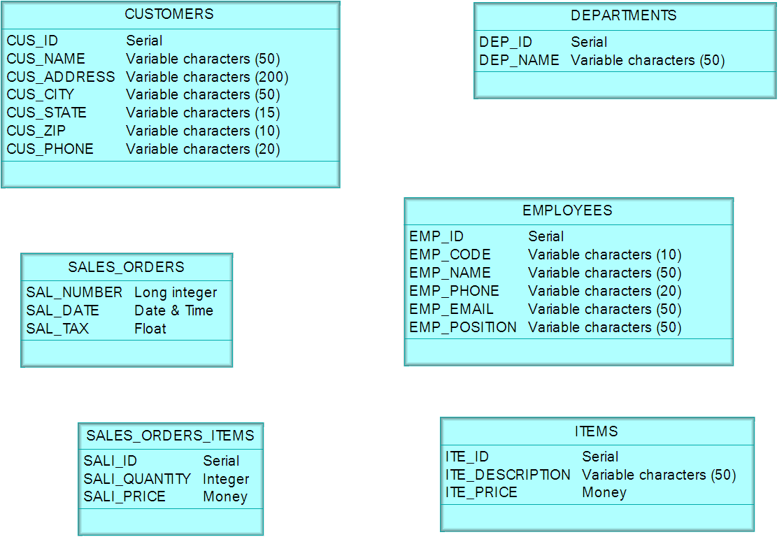
1.2.2. Identify Attribute

Slide 20
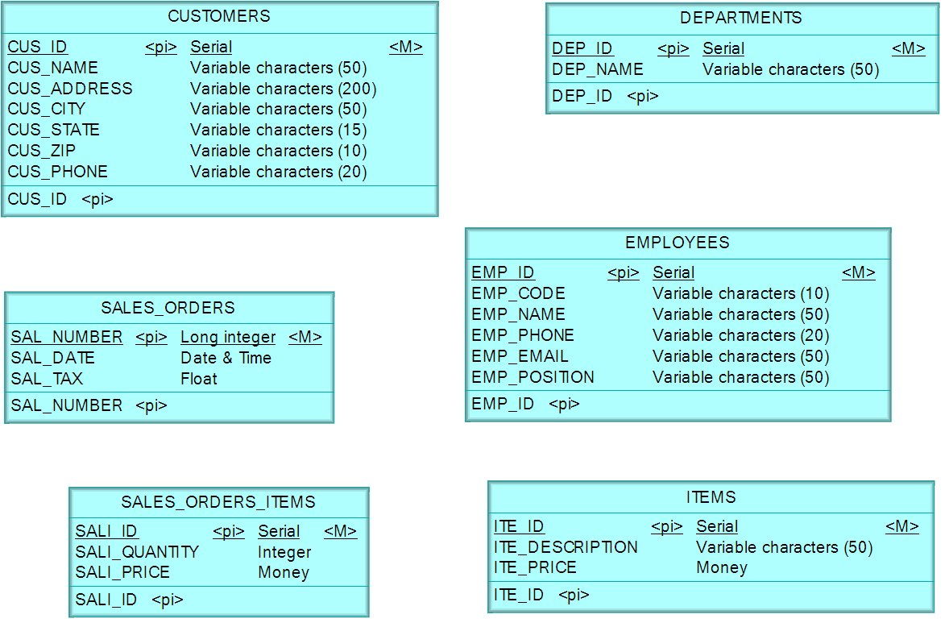
1.2.3. Identify Primary Identifier

Slide 21
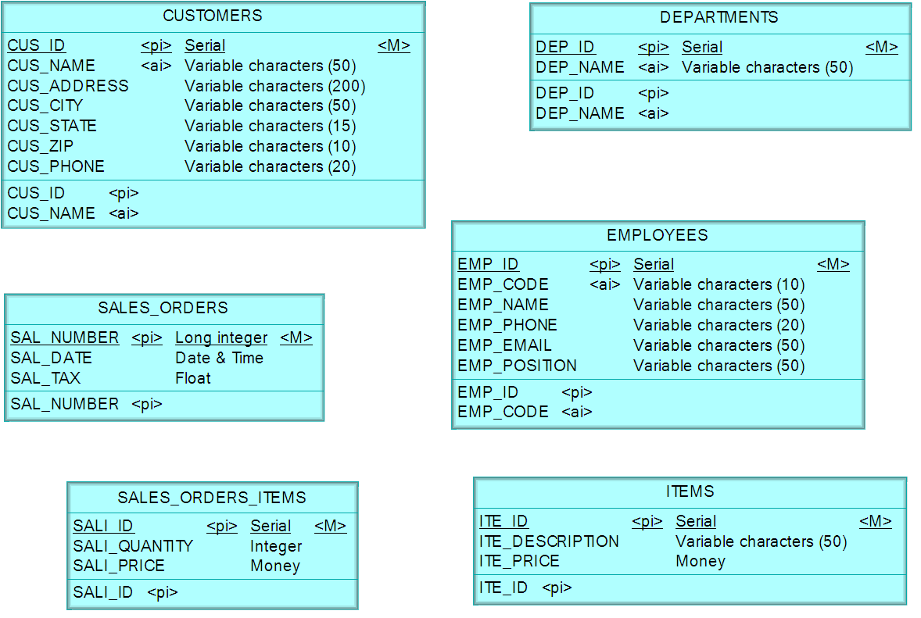
1.2.4. Identify Alternative Identifier

Slide 22

1.2.5. Identify Mandatory Attribute

Slide 23
1.2.6. Identify Relationship
1.2.6.1. Identify Maximum Cardinality
1.2.6.2. Identify Minimum Cardinality

Slide 24
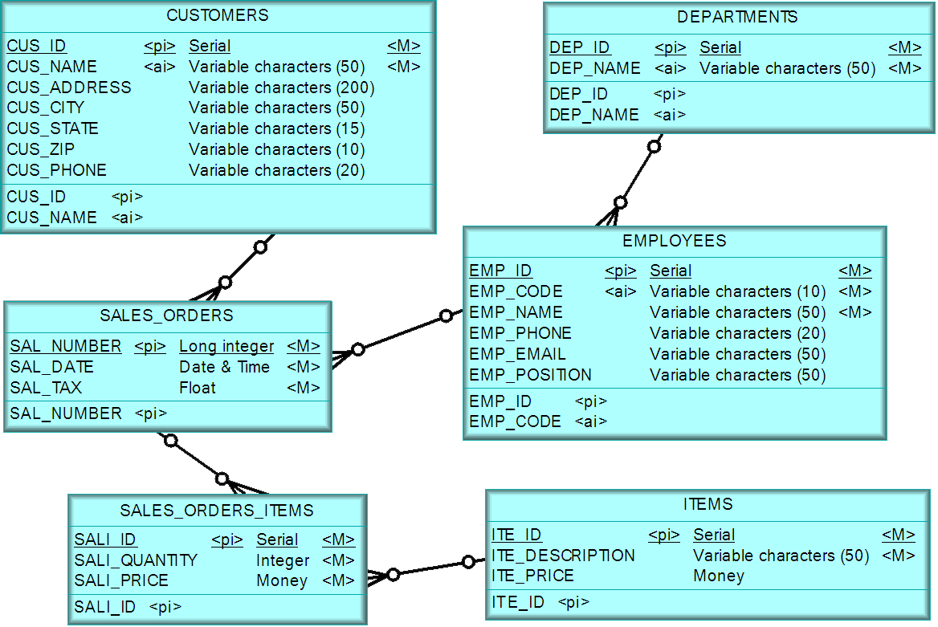
1.2.6.1. Identify Maximum Cardinality

Slide 25

1.2.6.2. Identify Minimum Cardinality

Slide 26
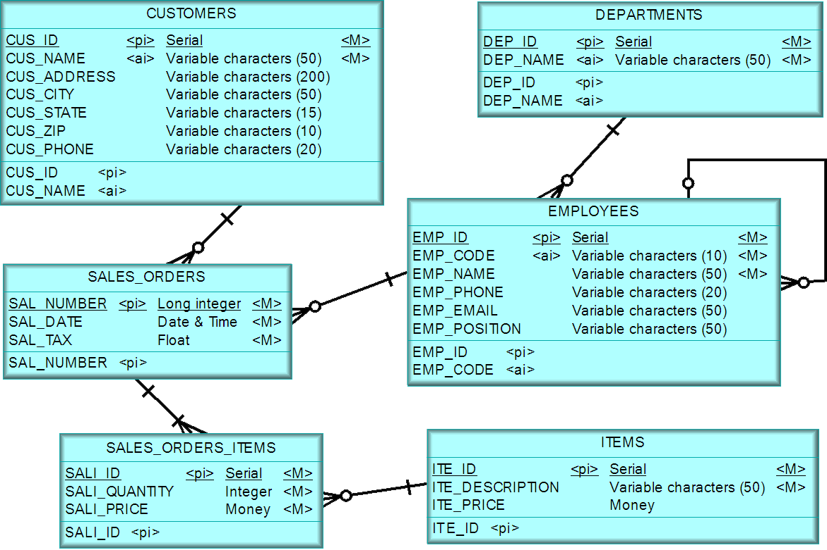
1.3. Identify Recursive Relationship

Slide 27
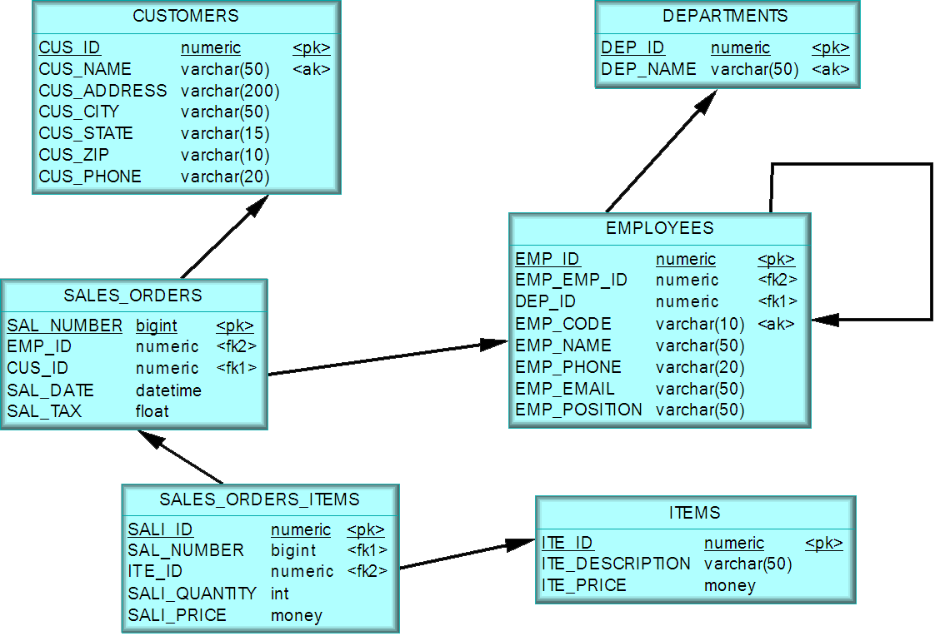
2. Physical Diagram

Slide 28

?

